Slide 1
Cloud Computing and Big Data Containers and the evolution of PaaS
Oxford University
Software Engineering Programme
Nov 2015

Slide 2
Contents
Containers
History and Approach
Docker
Docker ecosystem
PaaS in a container model
Futures

Slide 3
Sharing of resources vs Isolation
Dedicated data centre
Dedicated HW/ Shared Datacentre
More isolation
Virtual Machines
Containers
Shared OS Separate processes
Shared
Process
Better resource utilisation

Slide 4
Lightweight Virtualization history
zSystems Virtual Servers from late 1990s
(the mainframe really did do everything first)
Solaris Containers
AIX Workload Partitions
FreeBSD Jail
…

Slide 5
What is a Container?
A lightweight virtual server
Running within an Operating System
Providing various levels of isolation and control
E.g. Disk isolation and control
Network isolation
CPU and memory controls

Slide 6
Containers at Google
Every GMail session is a container
Try doing an export and then searching your email ☺
“Everything runs in a container”
2 billion containers launched a week
Borg
Any Google developer can instantiate their code in 10,000 instances any time they want
Takes about 5 minutes to start that many
Never exactly 10,000 because of failures

Slide 7
Linux Containers (LXC)
Virtualization inside the Linux Operating System
Not the only Linux option, but the most popular
Allows virtualization including CPU, memory, disk
Simple and effective

Slide 8
A sample of LXC
apt-get install lxc
lxc-create -t ubuntu -n cn-01
lxc-start –n cn-01
lxc-console –n cn-01
lxc-freeze –n cn-01

Slide 9
cgroups
Control of resources by process:
blkio — this subsystem sets limits block devices such as physical drives
cpu - access to the CPU.
cpuacct — this reports on CPU usage
cpuset — this controls usage by CPUs in a multicore
devices — this denies or grants access to devices
freezer — suspends and resumes tasks
memory — controls and reports on memory usage
net_cls — tags network packets with ids for control
net_prio — priority of network traffic per interface.
ns — the namespace subsystem.

Slide 10
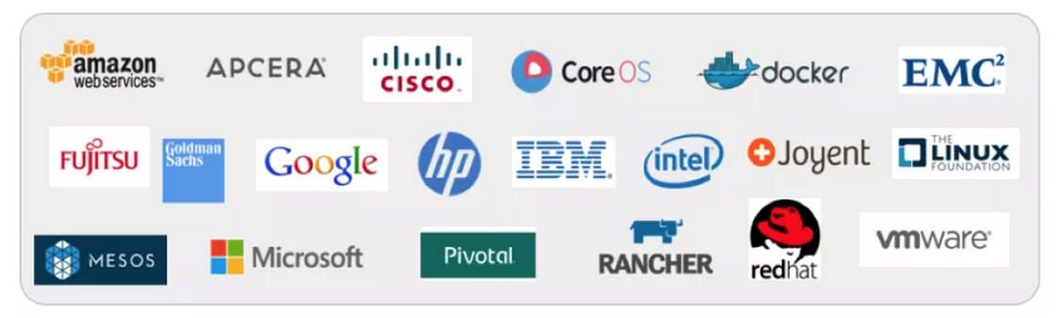
libcontainer and the Open Container Foundation
A standardised interface into the container layer
Part of runC the open runtime from Docker
A key basis of the Open Container Foundation

Slide 11

Cloud Native Computing Foundation
A new definition of “Cloud Native”
Container Packaged
Dynamically Managed
Micro-Service oriented

Slide 12
Docker on top of LXC
Docker adds several things to LXC and containerization:
Copy on write filesystem
Layered images and the ability to extend machines easily
Simple textual config file
Portable deployment across machines
Creating an ecosystem of images
Application centric
Each VM is a process (roughly speaking)
Plus others (auto-build, etc)

Slide 13
Why Docker?
The ecosystem has created a network effect
Metcalfe’s Law states
the value of a telecommunications network is proportional to the square of the number of connected users of the system
There is surely a corollary for ecosystems

Slide 14

How does Docker work?

Slide 15
Some simple Docker commands
apt-get install docker.io
docker pull ubuntu
docker run –t –i ubuntu /bin/bash
docker ps
docker commit funky_freo image
docker push image

Slide 16


Kittens vs Cattle (An unpleasant but effective analogy)

Slide 17

Blue Green Deployment
http://martinfowler.com/bliki/BlueGreenDeployment.html

Slide 18
Challenges with Docker and Solutions
Networking
It is very complex to connect different containers, even on a single machine
Weave Networks
SocketPlane (bought by Docker)
Clustering
Docker Swarm
Google Kubernetes
CoreOS
Apache Mesos
Lack of mutable file system
Flocker

Slide 19

Kubernetes
Open Source cluster management of containers
From Google, but separate from the Borg project

Slide 20
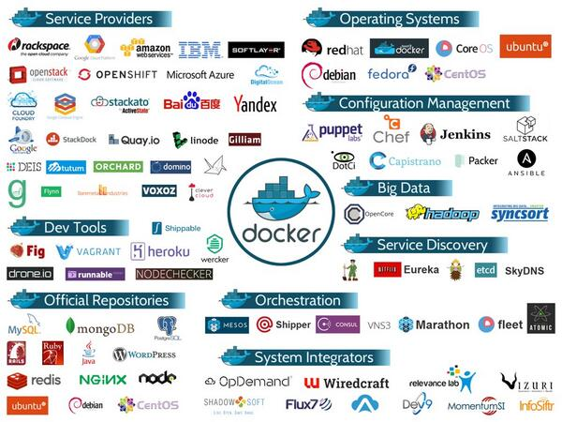
Docker ecosystem

Slide 21
Summary
Docker and the Container model
Lightweight virtualization and repeatability
Blue Green deployment
“Warehouse Scale” computing

